Slide 1


InstaGRAM USER ANALYTICS
Harsh Shrivastava

Slide 2

Problem Description
Analyzing User Interactions & Engagement on Instagram
To analyze the data and to gain insights we will use MySQL as a part of
Data Cleaning, Data Transformation, Data Analysis

Slide 3
APPROACH
First, we have created the database that contained 6 parameters/factors.
Secondly, we viewed the dataset to know its Structure
Third, analyzed the various problems that have occurred to gain insights
Forth, executed the solutions in a Query Based Manner Using MySQL

Slide 4
Tech-Stack Used
MySQL
MySQL Workbench
Excel
Notion (To help in documenting the whole Data Analysis Process)

Slide 5
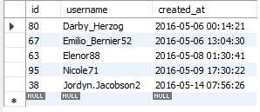
Insights
Loyal User Reward
Marketing team decided to reward the loyal users or who have been a part of the company longest
SELECT * FROM users ORDER BY created_at LIMIT 5;

Slide 6
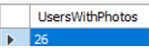
Insights
Inactive User Engagement
Gather inactive users to start posting in Instagram
SELECT COUNT(DISTINCT(username)) as UsersWithPhotos FROM users u LEFT JOIN photos s ON u.id = s.user_id WHERE s.id is NULL;

Slide 7
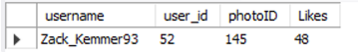
Insights
Contest Winner Declaration
User with the most likes in his/her post
SELECT u.username username, p.user_id, l.photo_id photoID, COUNT(l.photo_id) as Likes FROM photos p INNER JOIN likes l ON p.id = l.photo_id INNER JOIN users u ON u.id = p.user_id GROUP BY p.user_id, l.photo_id ORDER BY Likes DESC LIMIT 1;

Slide 8
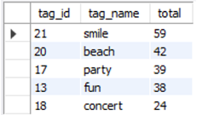
Insights
Hashtag Research
The most Popular Hashtag to use
SELECT pt.tag_id, tag_name, COUNT(tag_name) total FROM photo_tags pt LEFT JOIN tags t ON pt.tag_id = t.id GROUP BY pt.tag_id ORDER BY 3 DESC LIMIT 5;

Slide 9
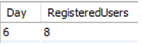
Insights
Ad Campaign Launch
Best day to launch the Ad Compaign
SELECT DAY(created_at) Day, COUNT(username) RegisteredUsers FROM users GROUP BY 1 ORDER BY 2 DESC;

Slide 10
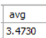
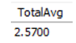
Insights
User Engagement
Wants to know if users are still active and posting on instagram
SELECT COUNT(p.id)/COUNT(DISTINCT(username)) avg FROM photos p INNER JOIN users u ON p.user_id = u.id; SELECT (SELECT count() from photos) / (SELECT count() from users) as TotalAvg;

Slide 11
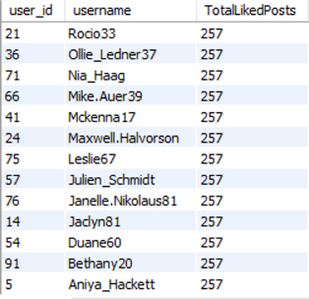
Insights
Bots & Fake Accounts
Accounts that have liked every post
SELECT user_id,username, COUNT(photo_id) TotalLikedPosts FROM likes l JOIN users u ON l.user_id = u.id GROUP BY 1 HAVING COUNT(photo_id) = 257 ORDER BY 2 DESC;

Slide 12

Results
Loyal User Reward : 5 Users that have given Loyal Reward Points (2016-05-06 to 2016-05-14)
Inactive User Engagement : 26 Users who haven’t posted a single post in Instgram
Contest Winner Declaration : Zack_Kemmer93 has liked every post
Hashtag Research : Top 5 hashtags are → concert , fun, party, beach, smile with total count 24-59
Ad Campaign Launch : Best day for Ad Campaign Launch is on 6th
User Engagement : Per Users who have posted there is avg of 3.47 posts, and 2.57 posts for total users
Bots & Fake Accounts : 13 Bots & Fake accounts have been observed
These Insights have provided us with great insights that will help to up scale the User Interface

